Slide 1


ROBOCAT PROJECT

Slide 2
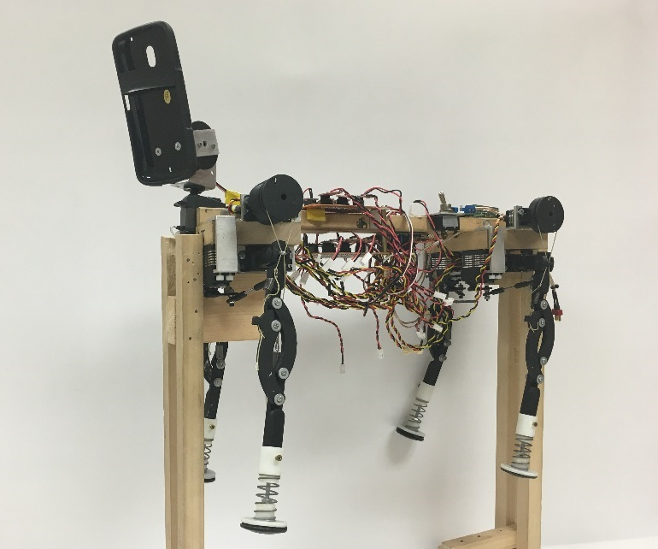
BACKGROUND
Accomplish the construction of a biomimetic bobcat robot able to:
Move forward and
make turns.
Receive and process
stimuli from the environment.

Slide 3
CURRENT STATUS
The RoboCat is now control by an Android OS based device (central board).
The central board communicates with the peripherals (Polulo and Arduino Mega) via USB.
Audio and Video recording and replay.
The face-recognition functionality has been accessed by the app.
Tactile stimuli is used to produce sound.

Slide 4
CURRENT STATUS
Response to voice commands (after pressing a button).
Color recognition and tracking.

Slide 5
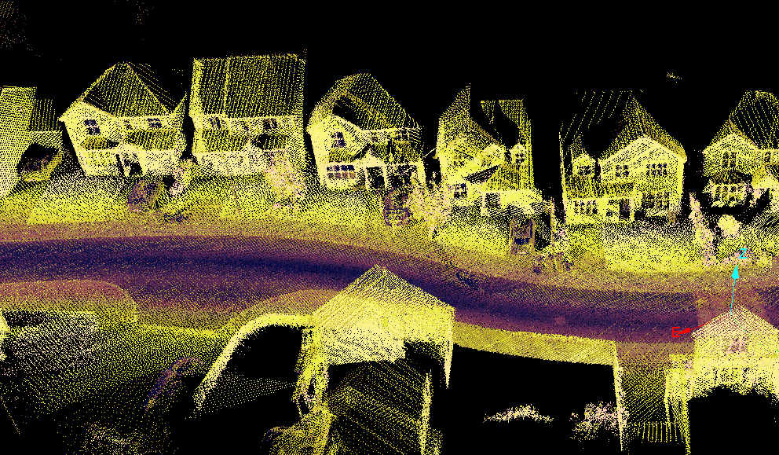
Client Requirements
SOUND SYSTEM:
Implement continuous speech recognition.
VIDEO SYSTEM:
Modify face recognition for shape recognition and positioning.
Add a range sensing mechanism.
(Additional camera, ultrasonic or
infrared sensor).
Environment mapping
(How fast and acquired can this be done).
http://www.renishaw.com/media/img/gen/f36bad00634242cb88592b11873c90ed.jpg

Slide 6
Client Requirements
OTHER HARDWARE FEATURES:
Check battery status.
Log data from accelerometer.

Slide 7
EE-ME Team Goals
Complete kinematics and dynamics model
Gait generation and control.
Autonomous walking.
Target following (with help from the CS team).

